Slide 1
GREEN Concepts in
SUSTAINABLE HOUSING
Sudarshan Raj Tiwari

Slide 2
Conceptualizing Green

Slide 3
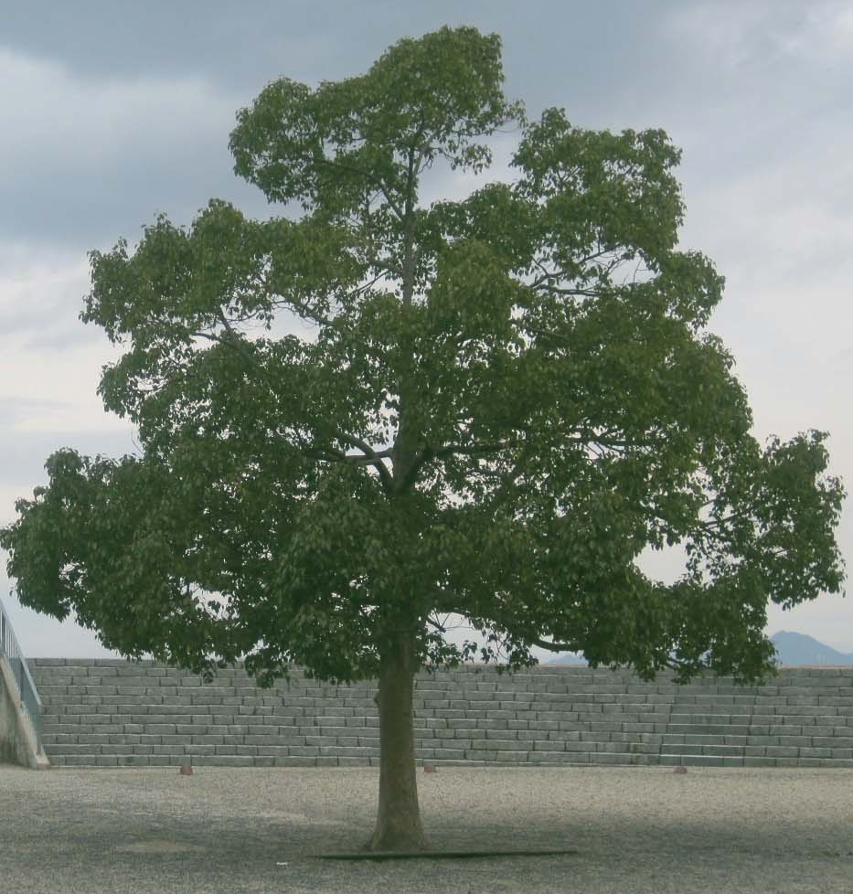
1
GREEN IS THE COLOUR
OF LEAVES OF TREES
2
CHROLOPHYLL MAKES LEAVES GREEN
3
CHROLOPHYLL SYNTHESIZES LIGHT INTO ORGANIC ENERGY(C+)
4
PHOTOSYNTHESIS NEEDS WATER AND CO2 IN AIR and MAKES O2
Plants display an amazingly sophisticated synthesis of the universal ecology of the five elements and environmental entities: SPACE AIR ENERGY WATER & EARTH

Slide 4
Nature’s way with CO2 in atmosphere and solar energy (HEAT)
CO₂
C
O₂

Slide 5
How much a part should Trees make of the urban space?
And
Why?
In one day a human being breathes oxygen equivalent to three cylinders.
Each oxygen cylinder on an average costs Rs 700, so in a day one uses Oxygen worth Rs 2100 and for a full year it is Rs 7,66,500.
If we consider an average life span of 65 years; the costs of oxygen we use become a staggering sum of Rs 500,00,000.
The TREE around make this oxygen free of cost for us.

Slide 6
1
IT IS ROOTED AND FIXED ON EARTH
2
IMMOBILIZED IT STANDS IN THE AIR AND DRAWS MOTION INTO ITS BRANCHES AND LEAVES
3
IT DRAWS WATER FROM THE EARTH AND TRANSPIRES INTO AIR
4
IT DRAWS LIGHT FROM THE AIR IN SPACE
5
CHLOROPHYL NEEDS SUN AND WATER TO BE

Slide 7
Conceptualizing Urban Sustainability

Slide 8
Urban Sustainability
Able to go on for ever!
Wake up calls on sustainability
    Resource Depletion
      Material, Energy, Environment
    Imbalanced Urban system and Waste
      Resource base outside the system
      Concentrative, hot, dry and grey
      Dwindles resources
      Pollutes environment > SAEWL

Slide 9
Heat Waste O₂ Food

Slide 10
Building & Urban Desertification
Making Towns hotter
  Buildings, human activities and machines have heat-holding and heat-generating character.
  Umbrella of waste products discharged into atmosphere (haze hood) traps heat there.
  Masonry, cement and bitumen surfaces absorb solar energy/ slower release than natural ground cover.
  Sensible heat remains as heat in urban areas.

Slide 11
Building & Urban Desertification
Making towns drier
  Buildings and building materials based on exclusion of water and water proofing
  Paving and Road surfaces: impervious to water (cf. natural cover/ sub-surface water) and falling ground water table
  Water collecting system and drain-off outside town (discharging system)
  Instant floods (cf. natural system of recharge)

Slide 12
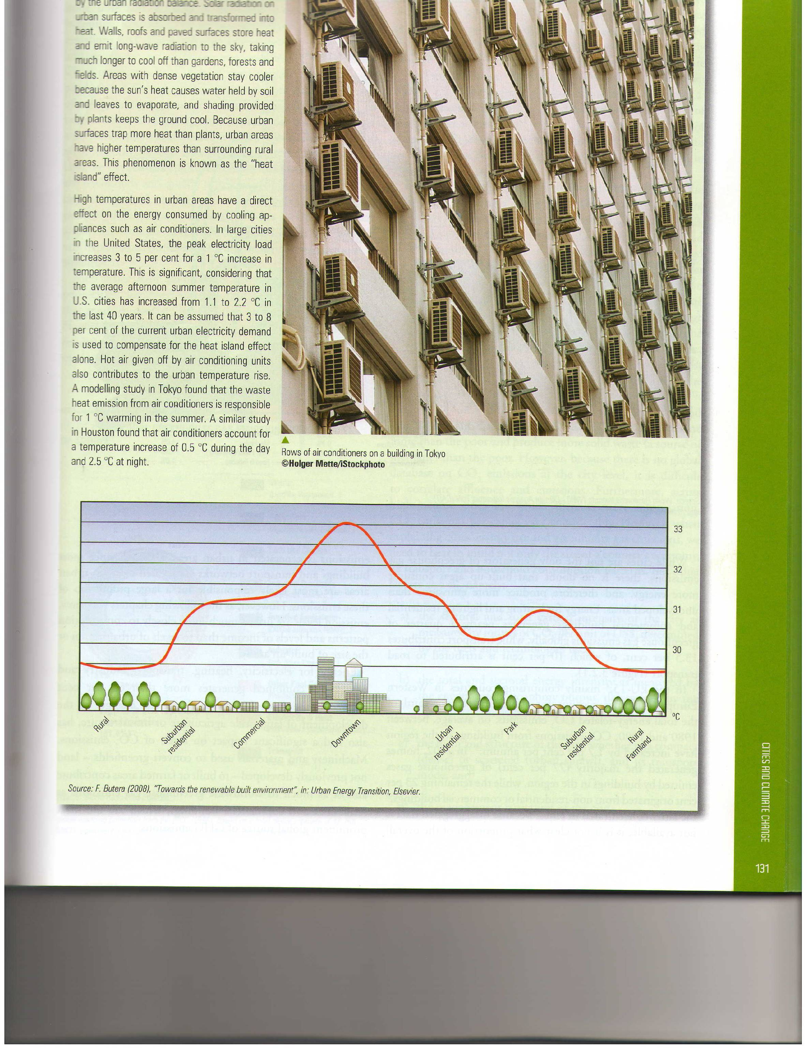
Urban Exclusion of Heat, Moisture and Plant Life
Making it a Hot, Dry and Grey entity

Slide 13
Un-sustainability: Urban Decay
Decay in urban systems occur due to
  Failure of the supporting capacity (a sum total of resources and regenerative gains)
  Failure of the assimilative/recycling capacity of Nature (a sum total of waste disposed)
  Failure of distribution of wealth: urban poverty and social degeneration
  Failure of social order: fragmentation and loss of community behavior

Slide 14
Green City
The greening of city should conceptually aim for
  Going GREEN
  Going wet
  Going cool

Slide 15
Green Sustainable Housing
In Planning – greening of environment
In Building – greening of architecture
Greening of life-style
Greening of wastes

Slide 16
Green Architecture
Doing Green Architecture is seeking to
  Keep the Human Health
    Physical Health
    Psychical Health (vaastu)
    Spiritual Health (vaastu)
  Keep the earth’s Health
    Environment
    Eco-system (earth, animals, plants and human inter-relationship)
    Conserving resources: materials and energy

Slide 17
Inclusive materials and methods
Architecture and indoor environment
Water excluding property
  Density, porosity
  Is moisture unhealthy?
Inclusiveness, performance and disposal, life-friendliness
Building inclusiveness
  material and technology

Slide 18
Green Building Technology
Reduce CO2 emissions
Sequester carbon from air
Reduce energy dependence, use clean energy, zero energy
Reduce waste, zero waste
Recreate habitat for other livings
Zero water, recharge ground with rain/waste water
Build these into DCOMD of building

Slide 19
Energy in material: embodied, transport & use

Slide 20
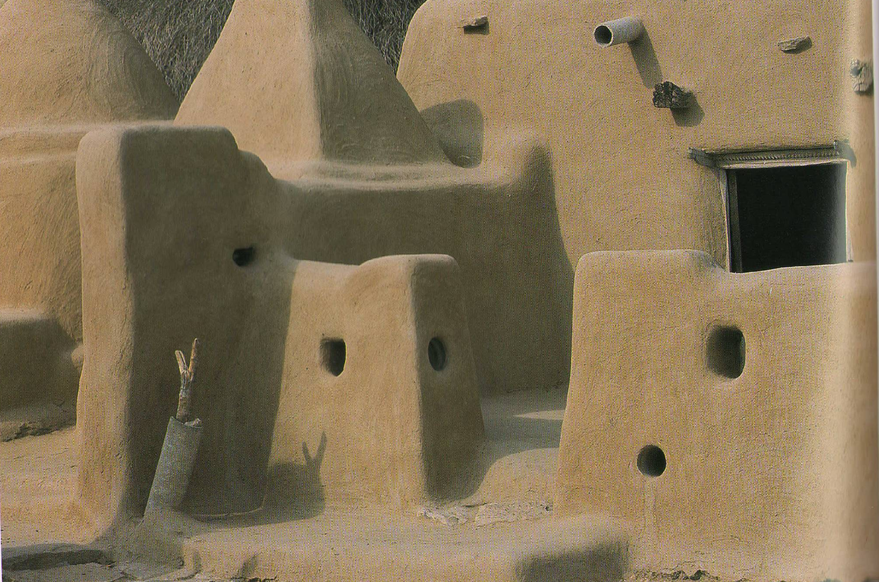
Built from ground, Localism?
Energy in material: embodied, transport & use

Slide 21
Inclusive materials and methods
Architecture and indoor environment
Water excluding property
  Density, porosity
  Is moisture unhealthy?
Inclusiveness, performance and disposal, life-friendliness
Building inclusiveness
  material and technology

Slide 22
Nature and Ecology in Traditional Wisdom
The Physical Nature
  an interplay of space, energy and matter
Elements and The Environment
    Pancha-tatwa
    sky (space), air, heat (energy), water and earth (matter in three states?)
    Interrelation, Interpenetration and Interaction

Slide 23
Interrelation, Interpenetration & Interaction

Slide 24
Global Environment
Heat and Earth, the couple

Slide 25
Water as Environment
in sky is air
in air is energy
in energy is water
in water floats land
on land the world tree rises

Slide 26
Water as Life Resource
Two are the life forms
  Plants and Animals
earth feeds on rain
Plants live on earth
(plants feed on water, air and energy)
animals feed on plants

Slide 27
Sustainable Water Management: Universal dos and do nots
Rain water
  right of earth over animals
  Right of plants over animals
  We should hot harvest rain from the midair
  We should only draw water from earth, just as the plants do
  Water is stored in nature by life and by earth itself
Water cycle and consequences of disturbing it
  Poking into universal ecological cycles will invite disaster
  Storing “water, air, land, sun and sky” outside of natural provisions is not feasible for humankind

Slide 28
Reframing an approach
Key Issues
  CO2 emission, heat emission, energy intensive lifestyle
  Technological obsolescence and waste
  Heat holding and water excluding property
Key Approaches
  Interaction between Land, Air, Heat, Water plus Plant and Animal Life
  Reduction of Co2 and Heat
  Water inclusive architecture and technology
  Making land COOL, MOIST and GREEN
  Increasing disposability/Reducing Obsolescence

Slide 29
Tree on Earth - Making Grey Green
West
  Ebenezer Howard’s Garden City
  Le Corbusier’s Les 5 points d’une architecture nouvelle, 1926
  Green Architecture
Kathmandu
  Paved squares, no central public green but Keba
  Khyo, green lots on the periphery

Slide 30
Earth on Water-Making dry Moist
Modern City
  Urban system takes no action to put moisture into the ground
  Water proof piping for supply and drainage
  Wetness and dampness – a public health hazard!
  Surface drains and sealed pavements
Recently-
  Rain water harvesting?
    Let Earth and Tree “harvest” the Rain first
  Recharging wells, holding storage
  Porous asphalt for paving has been developed!

Slide 31
Earth on Water-Kathmandu
Water accepting technology
  Open jointed Brick or Stone slab paving
  Surface drains harvesting neighborhood waste water
  Use of Porous seams – Bahrabarse Inar
  Jhingati roof
Town inclusive towards Moisture

Slide 32
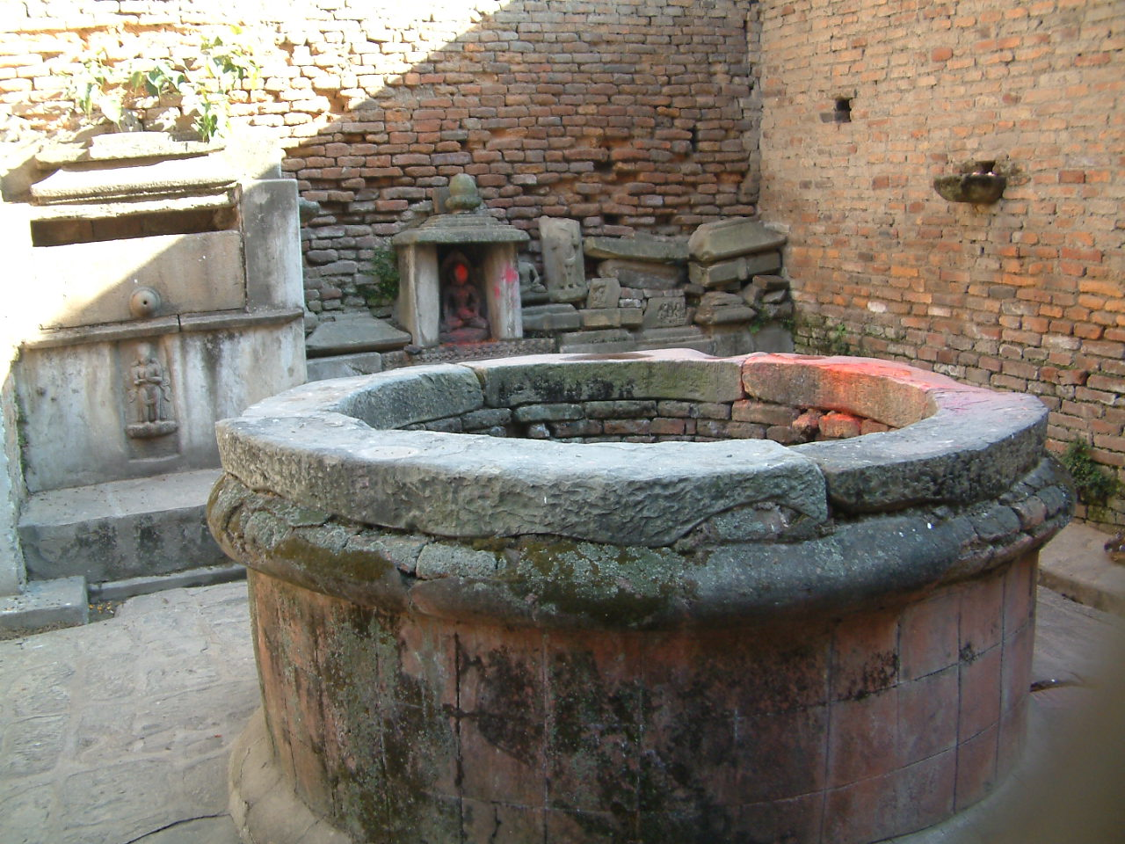
Earth on Water-Harvesting Rain!

Slide 33
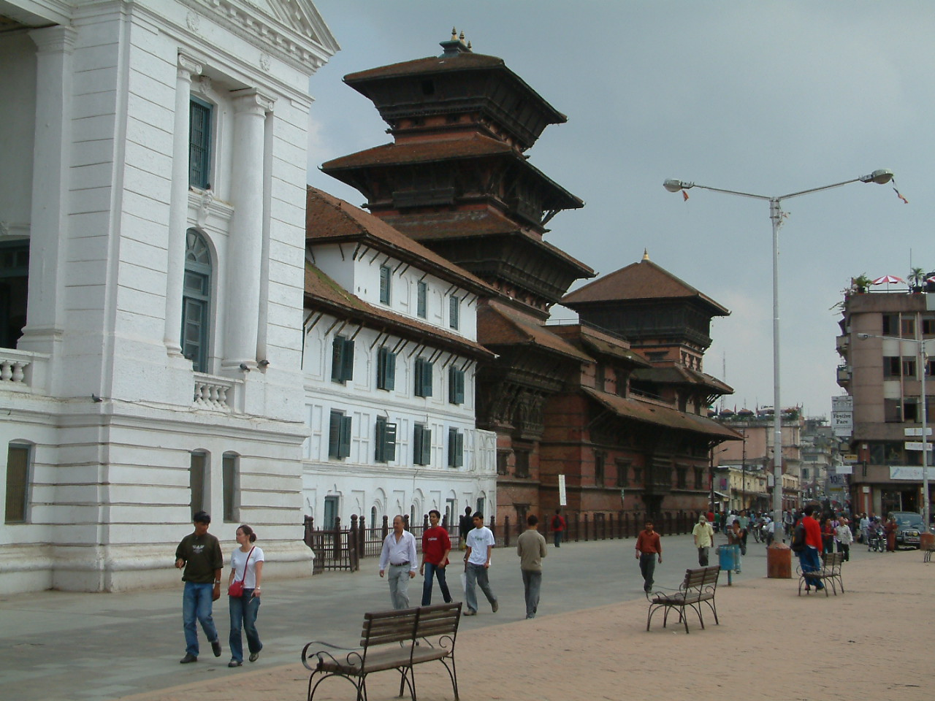
Earth on Water-Porous Pavings

Slide 34
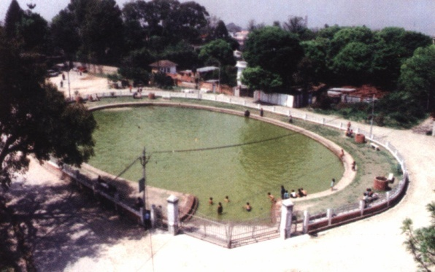
Earth on Water-Recharging Ponds

Slide 35
Cooling the Earth, using excess heat
Towns working towards using heat
  Jhingati tiles (earthenware not glazed/stoneware)
  Saaga and composting
  Waste chain linked to Food chain

Slide 36
Recycling Through Use of
Extra Urban Heat
*
Compost and
Sagah
v]tsf] k]6df k]6sf] v]tdf
FOOD
WASTE
MANURE
FARM

Slide 37
Using Perishable materials
Degradability of materials
  Action of heat, air, solid matter (abrasion)
  Action of water
Nepali Traditional architecture
  Based on wood, brick
  Wet Monsoons and tradition of conservation by replacement
  Generally water inclusive material and technology
  Dachiapa Glazing material (red moss)

Slide 38
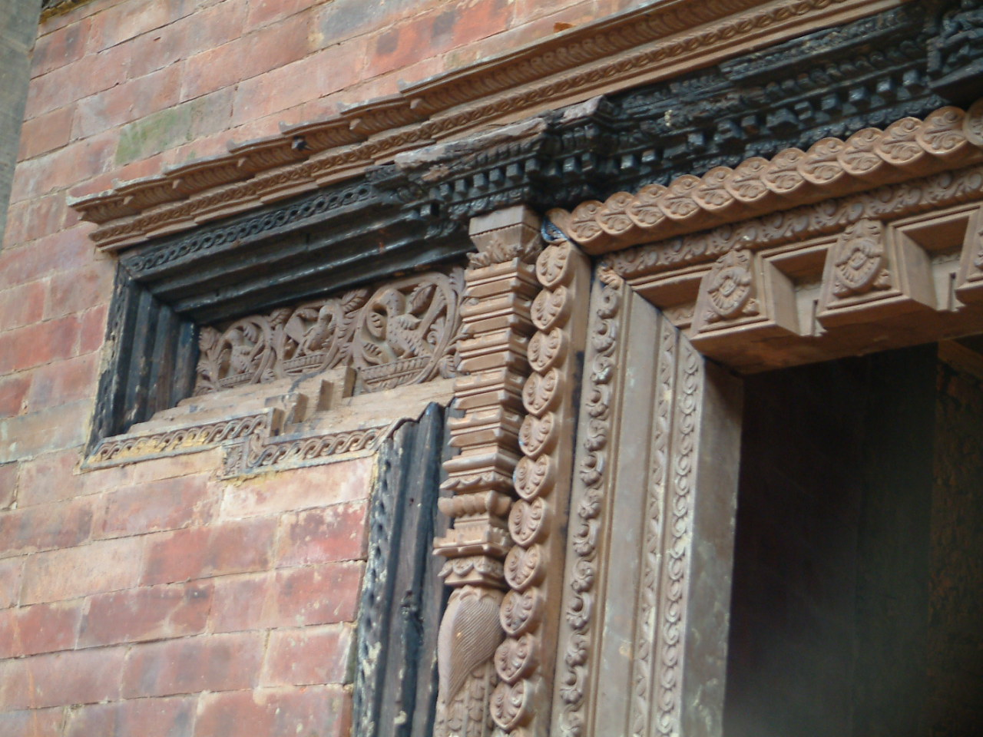
Using Perishable materials

Slide 39
Living together with Animals
Hiti – the pit conduit
  Supply side
  Filters Regulators and Deep pit
  Drainage side
Maintenance free architecture
  Fish, frog and snakes at work
  Plankton feeding the fish, frog feeding on fish, snake feeding on frogs!
  Ecozoic technology of flushing deep closed darins?

Slide 40
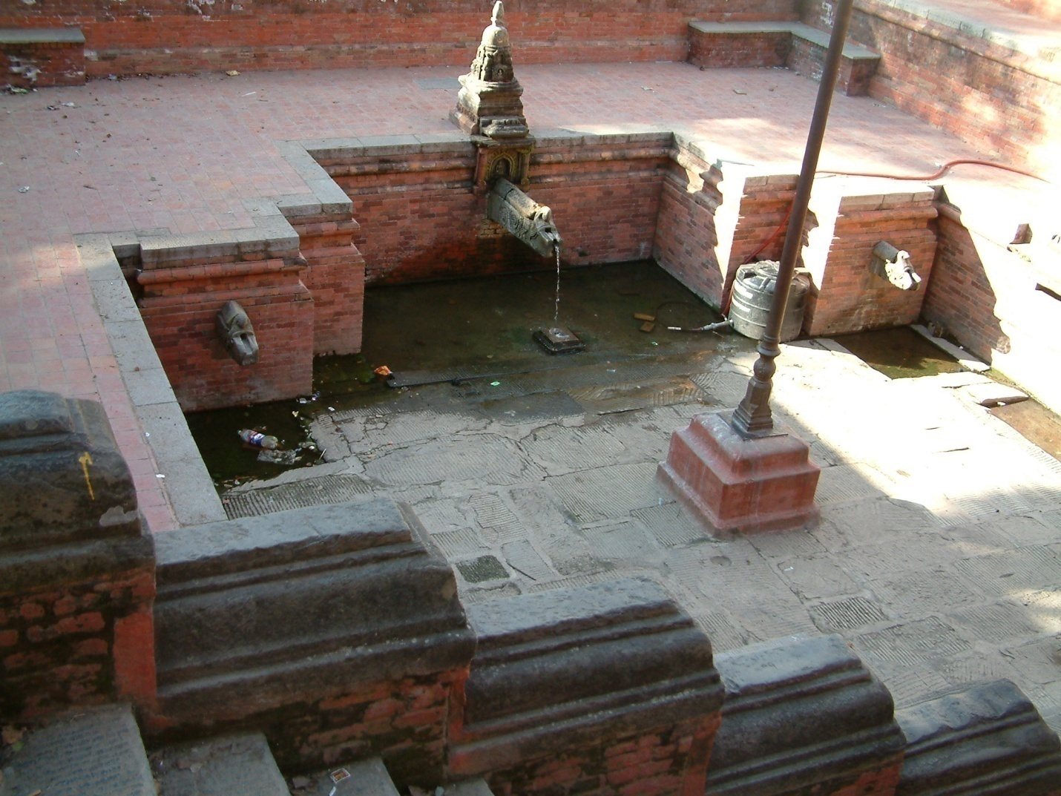
The Pit Conduit: Hiti

Slide 41
Conceptual Agenda: Green and Brown
The Green Agenda | The Brown Agenda
Natural systems to be used as urban services | Human systems to make cities healthy and livable
Ecosystems that provide green open space for biodiversity and recreation | Waste systems to recycle and remove (solid, liquid and air) wastes
Water system used to tap natural flow for water supply and waste disposal | Energy systems to provide power, heating, cooling and lighting
Climate and air systems that provide for healthy life | Transport systems to enable mobility and fuel
Agricultural and forestry systems for food and fibre | Building and material systems that provide physical basis of life in cities
Adapted from UN HABITAT Literature

